Slide 1
CSCI 680
SWING DRAG AND DROP AND DATA TRANSFER, INTRODUCTION WITH LIVE EXAMPLES
Michele Fattoruso
Michele Fattoruso
Notes:
1

Slide 2

What is Drag & Drop
Drag and Drop is a pointing device gesture in which the user selects a virtual object by “grabbing” it and dragging it to a different location or onto another virtual object.
Michele Fattoruso
2
Notes:
2

Slide 3
What is Drag & Drop
Is not found in all software, through it is a fast and easy-to-learn technique.
Along with cut, copy and paste ( collectively called data transfer) are essential features of most applications.
Michele Fattoruso
3
Notes:
3

Slide 4
D&D in Java
Technically speaking, all Swing components support drag and drop, as the data transfer mechanism is build into every JComponent
Components like JColorChooser, JtextPane, JtextField recognize the drag gesture once the setDragEnabled(true) method is invoked on the component.
Michele Fattoruso
4
Notes:
4

Slide 5
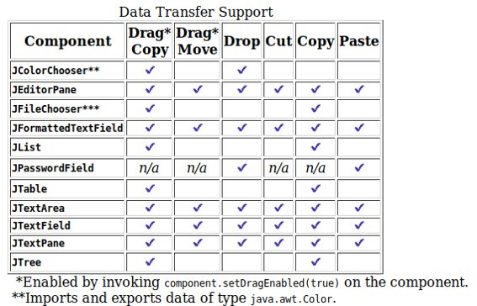
D&D in Java
Michele Fattoruso
5
Notes:
5

Slide 6
The TransferHandler Class
As its name suggests, the TransferHandler provides an easy mechanism for transferring data to and from a JComponent
Most components are provided with a default transfer handler.
You can create and install your own transfer handler on any component.
There are three methods used to engage a TransferHandler on a component:
Michele Fattoruso
6

Slide 7
The TransferHandler Methods
setDragEnabled(boolean) - BasicDnD:260
turns on drag support. (The default is false.) This method is defined on each component that supports the drag gesture;
setDropMode(DropMode) - BasicDnD:196
configures how drop locations are determined. This method is defined for JList, JTable, and JTree;
setTransferHandler(TransferHandler) - BasicDnD:104
used to plug in custom data import and export. This method is defined on JComponent, so it is inherited by every Swing component.
Michele Fattoruso
7

Slide 8
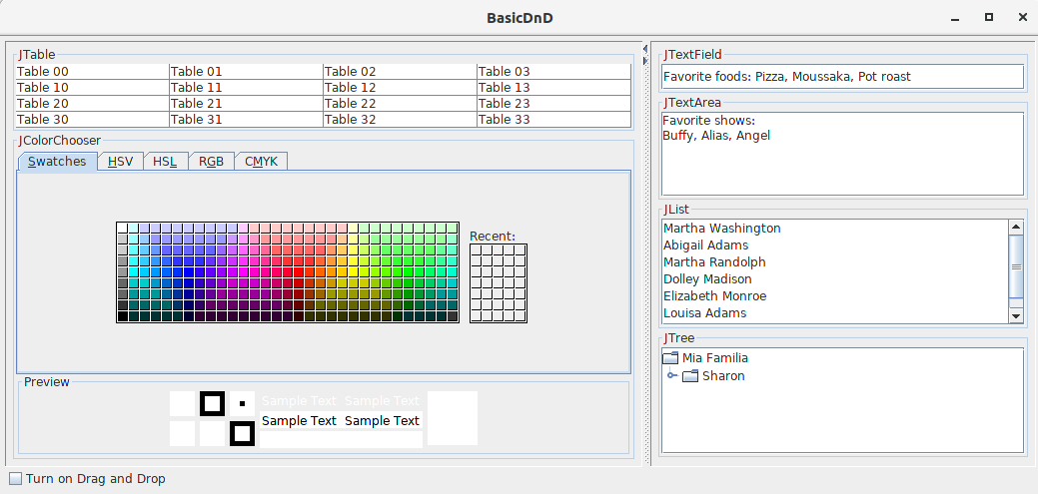
Let's see it in Action
Michele Fattoruso
8

Slide 9
The TransferHandler methods for exporting data
getSourceActions(JComponent)
This method is used to query what actions are supported by the source component, such as COPY, MOVE, or LINK, in any combination.
createTransferable(JComponent)
This method bundles up the data to be exported into a Transferable object in preparation for the transfer.
exportDone(JComponent, Transferable, int)
Invoked after the export is complete. When the action is a MOVE, the data needs to be removed from the source after the transfer is complete — this method is where any necessary cleanup occurs
Michele Fattoruso
9

Slide 10
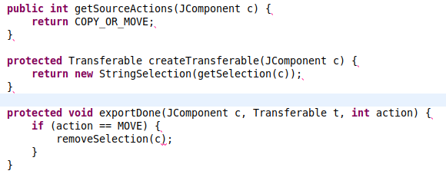
Sample implementations of the export methods
Michele Fattoruso
10

Slide 11
The TransferHandler methods for importing data
canImport(TransferHandler.TransferSupport)
This method is called repeatedly during a drag gesture and returns true if the area below the cursor can accept the transfer, or false if the transfer will be rejected.
importData(TransferHandler.TransferSupport)
This method is called on a successful drop (or paste) and initiates the transfer of data to the target component. This method returns true if the import was successful and false otherwise.
Michele Fattoruso
11

Slide 12
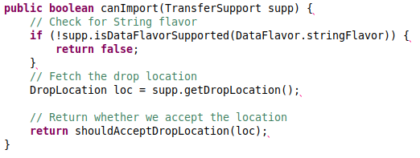
Sample implementations of the import methods
Michele Fattoruso
12

Slide 13
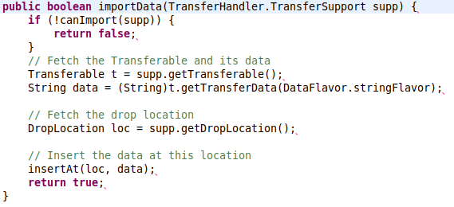
Sample implementations of the import methods
public boolean importData(TransferSupport supp) { if (!canImport(sup)) { return false; } // Fetch the Transferable and its data Transferable t = supp.getTransferable(); String data = t.getTransferData(stringFlavor); // Fetch the drop location DropLocation loc = supp.getDropLocation(); // Insert the data at this location insertAt(loc, data); return true; }
Michele Fattoruso
13

Slide 14
How do you want the drop location to be interpreted?
setDropMode method supports the following drop modes.
DropMode.USE_SELECTION. (Default)
On a drop the selected item shifts to the drop location.
DropMode.ON
This mode can be used to drop on top of existing list items.
DropMode.INSERT
Restrict to selecting the space between existing list items
DropMode.ON_OR_INSERT
is a combination of the ON and INSERT modes.
Michele Fattoruso
14

Slide 15
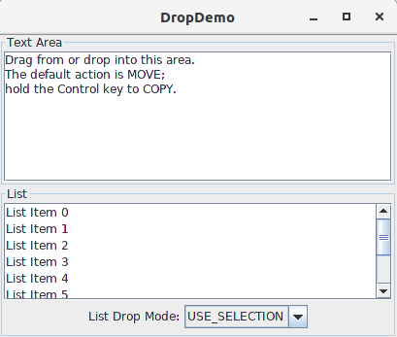
How the different drop works
DropDemo/DropDemo.java:57
Michele Fattoruso
15

Slide 16
how you want the drop location to be interpreted
Every drag source (Java based or otherwise) advertises the set of actions it supports when exporting data.
If it supports data being copied, it advertises the COPY action
if it supports data being moved from it, then it advertises the MOVE action.
For Swing components, the source actions are advertised through the getSourceActions method.
In the canImport method, the target's TransferHandler decides whether to accept the incoming data.
Michele Fattoruso
16

Slide 17
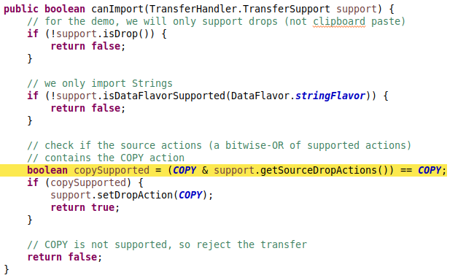
An implementation that explicitly chooses the COPY action,
Michele Fattoruso
17

Slide 18
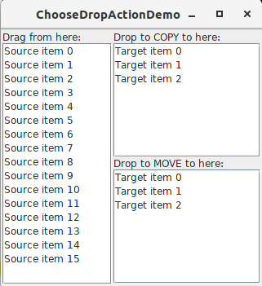
Drop Action demo
ChooseDropActionDemo.java:132
Michele Fattoruso
18

Slide 19

So, What?
Can we just move strings with a TransferHandler
Michele Fattoruso
19

Slide 20
TransferHandler is more than that
The DataFlavor class allows you to specify the content type of your data.
You need to specify a DataFlavor when fetching the data from the importData method.
Several flavor types are predefined for you:
imageFlavor represents data in the java.awt.Image format. This is used when dragging image data.
stringFlavor represents data in the most basic form of text — java.lang.String. This is the most commonly used data flavor for most applications.
javaFileListFlavor represents java.io.File objects in a java.util.List format.
For most applications, this is all you need to know about data flavors
Michele Fattoruso
20

Slide 21
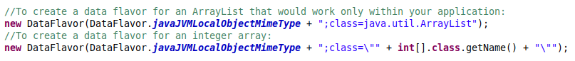
What if I want more?
If you require a flavor other than these predefined types, you can create your own.
Michele Fattoruso
21

Slide 22
TransferHandler is for every JComponent
We can also set a TransferHandler directly on a top-level container, such as JFrame and JDialog.
This is particularly useful for applications that import files, such as editors, IDEs, image manipulation programs
Michele Fattoruso
22

Slide 23
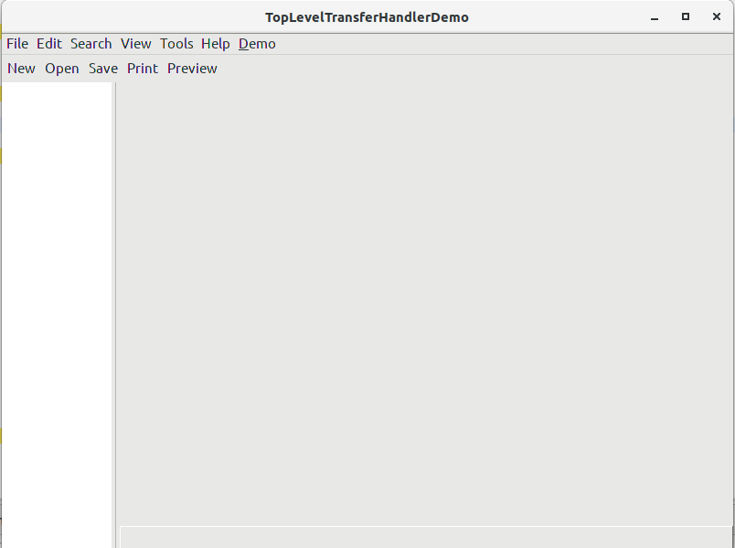
JFrame TransferHandler
TopLevelTransferHandlerDemo.java:232
Michele Fattoruso
23

Slide 24

QUESTIONS??
Michele Fattoruso
24

Slide 25

What I used it for??
25

